Slide 1
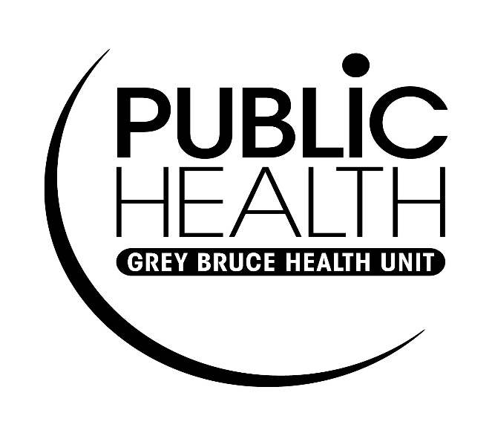
Safe Handling and Disposal of Sharps

Slide 2
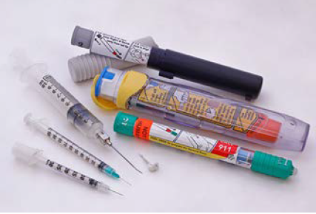
What is a Sharp?
A sharp is any item having corners, edges, or projections capable of cutting or piercing the skin:
  Needles
  Needles with syringes
  Needles from vacutainers
  Needles with attached tubing
  Insulin pen
  Blades (razors, scalpels, exacto, etc.)
  Broken glass that has come into contact with blood or other body fluids

Slide 3
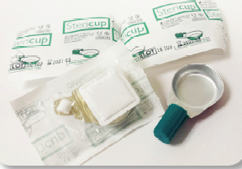
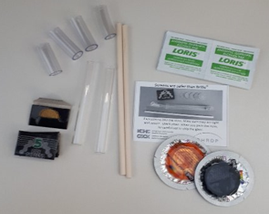
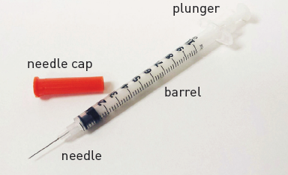
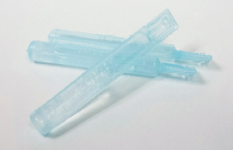
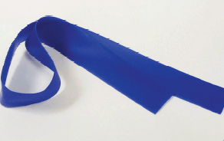
Drug Paraphernalia Should be Treated as Sharps
Safer Crack Kit
Cooker
Sterile Water
Crystal Meth Pipe
Tourniquet
Notes:
People may also find improperly discarded drug equipment in communities. This equipment may contain traces of blood, body fluids or hazardous substances and should be treated the same as you would a sharp/needle.
Top right picture shows cookers: Used for mixing and heating the drug prior to injection. Sterile water can be used to prepare injection drugs and come in clear plastic vials. Tourniquets are a thin strip of flexible rubber, used to make the veins stand out more to make injection easier. Crystal meth pipes used to smoke crystal meth. Safer crack kit, used to smoke crack. Providing all of this equipment is part of a large harm reduction strategy to prevent the spread and transmission of blood borne infections. It can prevent people from re-using or sharing equipment. It is evidenced based and cost effective.

Slide 4
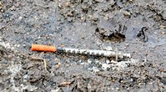
Improper Disposal of Sharps is a Community Concern
People use sharps for a variety of reasons. Some medical conditions require people to use needles such as diabetes, cancer, or arthritis. People also use needles for non-medical injection drug use.
Improperly discarded sharps in public places is a challenge that many communities face.
  A community approach is required to address this issue.
  When needles are discarded improperly in a community, it is often a result of not having a place to properly dispose of them.
  Most people will dispose of needles safely if safe choices are made available (Bridgeman & LePage, 2017, p.3).

Slide 5
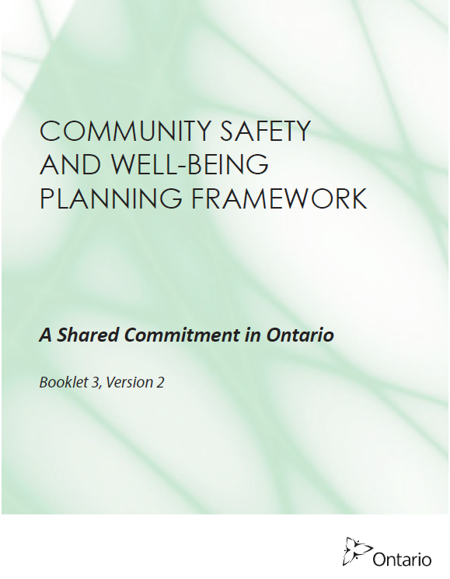
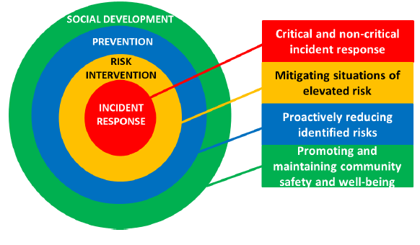
The Community Safety & Well-being Planning Framework
Notes:
Community Safety and Wellbeing Plan:
https://www.mcscs.jus.gov.on.ca/english/Publications/MCSCSSSOPlanningFramework.html
“This booklet supports the legislative requirements related to mandating community safety and well-being planning under the Police Services Act (effective January 1, 2019). As part of legislation, municipalities are required to develop and adopt community safety and well-being plans working in partnership with a multi-sectoral advisory committee comprised of representation from the police service board and other local service providers in health/mental health, education, community/social services and children/youth services” (MCSCS, 2017, p.5).
“This approach allows municipalities to take a leadership role in defining and addressing priority risks in the community through proactive, integrated strategies that ensure vulnerable populations receive the help they need from the providers best suited to support them” (MCSCS, 2017, p.5).
Improperly discarded sharps is an issue that requires a community approach and could be an important concern to address when completing this planning.

Slide 6
Improperly Discarded Sharps can Result in Sharps Injury
Can affect anyone but some people may be at higher risk:
Maintenance and custodial staff, grounds staff
(garbage and recycling removal)
Accidental needle stick injuries can expose people to blood borne infections such as Hepatitis B, Hepatitis C and HIV; although the risk is low it is still important to be cautious
Notes:
Never push down garbage or recycling with your hands or feet. Do not reach with your hands for objects you cannot see (Toronto Public Health, 2018, p.15).
Information on Blood borne infections if participants have questions:
HIV (or human immunodeficiency virus) weakens your immune system, your body’s built-in defence against disease and illness. This virus is transmitted through contact with an infected person’s blood or body fluids. Anyone can be infected with HIV. You can have HIV without knowing it. You may not look or feel sick for years, but you can still pass the virus on to other people. Without HIV treatment, your immune system can become too weak to fight off serious illnesses. HIV can also damage other parts of your body. Without treatment, you can eventually become sick with life-threatening infections. This is the most serious stage of HIV infection, called AIDS (or acquired immunodeficiency syndrome).
Hepatitis C is a specific liver disease caused by the hepatitis C virus (HCV). Hepatitis C is a virus that injures the liver. This virus is transmitted through contact with the blood of an infected person. The liver is a very important organ in your body. It helps the body fight infections, break down toxins (poisons) and drugs, digest food, and more. You can’t live without it. You can live with hepatitis C for 20 to 30 years or more without feeling sick even though the virus is injuring the liver. Over time, the injury to the liver gets worse, making it hard for this organ to work properly. There is treatment for Hep C.
Hepatitis B is a liver disease caused by the hepatitis B virus (HBV). This virus is transmitted through contact with blood and body fluids of an infected person. HBV is far more infectious than HIV and can be prevented by a vaccine. People who have not been vaccinated may be at risk of getting infected. About 95 percent of adults will recover within 6 months of becoming infected (acute hepatitis B) and as a result will develop lifelong protection against it. The remaining 5 percent are unable to clear the virus and will become chronically infected. Chronic hepatitis B infection is treatable.
Follow this link for more information on blood borne infections: www.catie.ca

Slide 7
If you find improperly discarded sharps…
On private property: Owner’s responsibility and resources available from Public Health to support individuals to safely dispose of sharps
While working: If trained/have equipment, following organizational procedures
Public place: Some police services and municipalities will respond; check with your local services

Slide 8
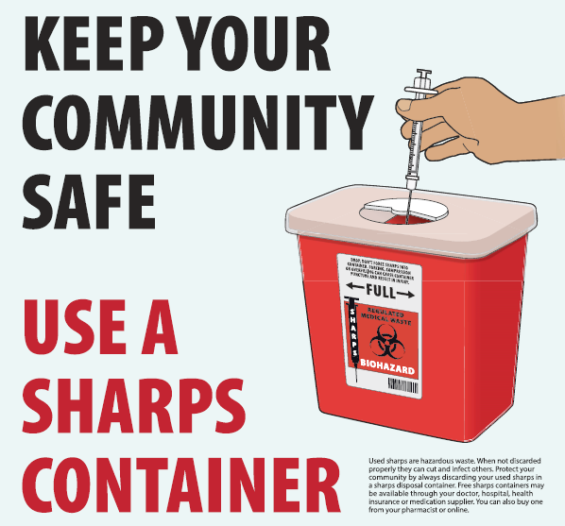
Sharps must be disposed of in sharps containers and managed as biohazardous waste.
Notes:
Explain sharps containers are the safest way to dispose of biohazardous waste.

Slide 9
Disposal of Sharps
DOs | DON’Ts
Use PPE (personal protective equipment) | Handle sharps with your hands
Use sharps containers | Force sharps into containers
Prepare for disposal | Fill containers more than ¾ full
Participate in training | Empty sharps containers
Report unsafe environments or practices | Recap needles or break the tips off
Track found needles/sharps | Use hands or feet to compact garbage
Follow your workplace policy and procedure | Pick up more than one sharp at a time
Notes:
Always use gloves, tongs, and closed toe shoes when disposing of sharps; always use this equipment to pick up garbage.
Do not reach with your hands for objects you cannot see.
Perform routine checks of areas where there is a risk of discarded sharps.
(Toronto Public Health, 2018, p.15)

Slide 10
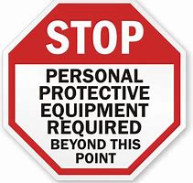
What is PPE?
Equipment required to protect you from injuries
Recommended PPE for handling sharps:
Puncture resistant or nitrile gloves
Tongs
Closed toe foot wear
Biohazardous waste containers (sharps containers)
Notes:
Puncture resistant gloves can be purchased from medical waste companies.

Slide 11

Safe Sharp Disposal
Follow your organizational policy and procedure for handling sharps
Participate in training
Track found sharps to identify if there are trends or locations that can support further policy development

Slide 12
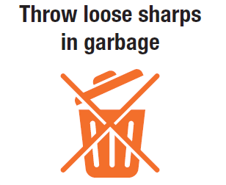
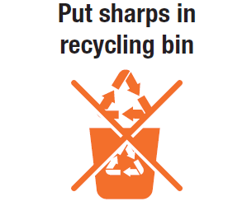
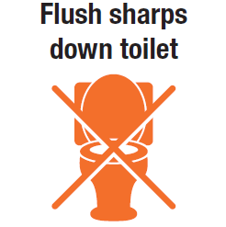
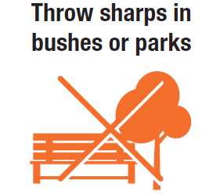
Steps to Safe Sharps Disposal
Do Not….

Slide 13
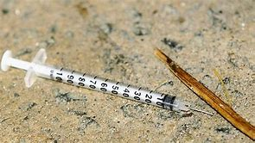
Steps to Safe Sharp Disposal
Assemble required equipment:
  Gloves
  Tongs
  A sharps container
Put on closed toe shoes
Bring equipment to the site of the found sharp
Assess the site for health hazards
Notes:
Before proceeding with safe sharps disposal, assess the site of the found sharp/drug equipment for potential health hazards. Examples of possible health hazards include: additional sharps/drug equipment, environmental hazards such as ice, water or fire hazards, presence of an unknown substance, etc.
If safe to proceed, continue with safe sharps disposal. If unsafe to proceed, contact supervisor for direction.

Slide 14
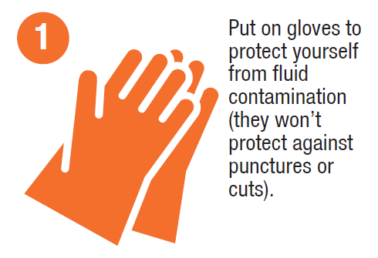
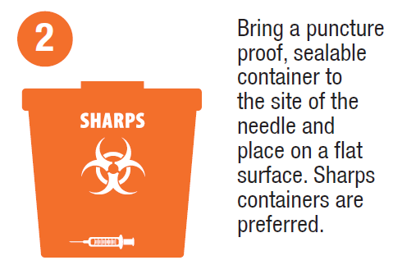
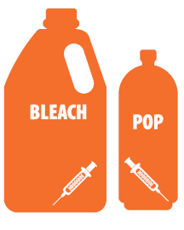
Steps to Safe Sharps Disposal
Ensure your container is within arm’s reach of where you are working!
Notes:
Don gloves to protect yourself from fluid contamination.
Bring your sharps container to the site of the found sharps and place it on a flat surface near the sharp.
Ensure your container is within arm’s reach of where you are working.

Slide 15
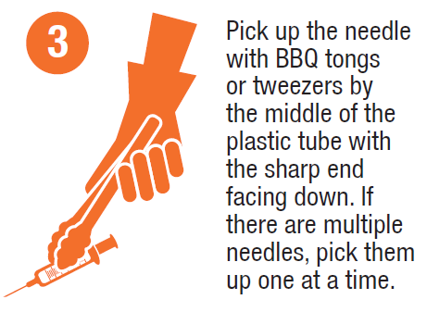
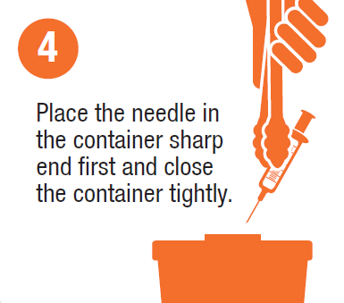
Steps to Safe Sharps Disposal
Notes:
If you are planning on using the container to dispose of sharps on more than one occasion, close the container, but do not lock it.

Slide 16
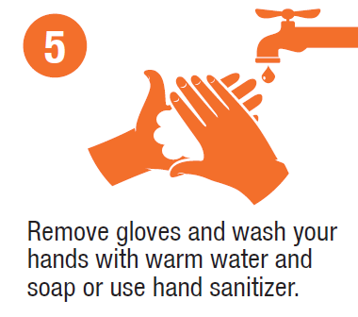
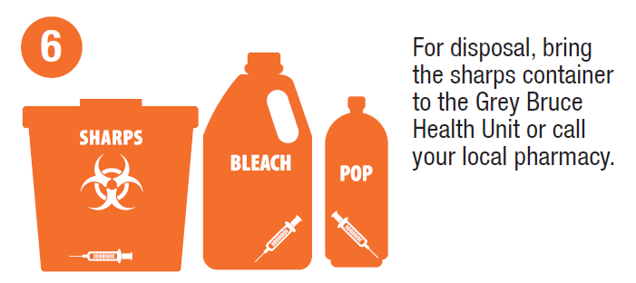
Steps to Safe Sharps Disposal
Notes:
**For disposal, some organizations or municipalities may have their own contract with a medical waste disposal company.

Slide 17
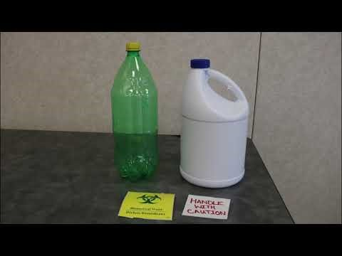
Safe Sharps Disposal
Notes:
Video on safe sharps disposal: https://www.youtube.com/watch?v=1kUzbmWYOdo

Slide 18
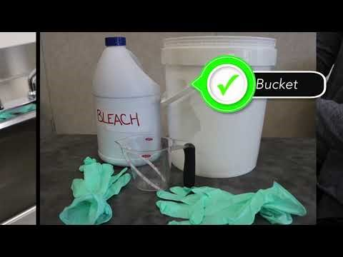
Cleaning and Disinfecting Tongs Used for Sharps Disposal
Notes:
Link to video: https://www.youtube.com/watch?v=X7tQc1wMHxg
If using the tongs to dispose of sharps:
On one occasion-> Place tongs in the garbage following use
On more than one occasion-> Clean and disinfect tongs after use
Assemble equipment: Gloves, household bleach, water, measuring cup, bucket
Don gloves
If visibly soiled, clean tongs with soap and water and rinse
Remove gloves and wash hands; put on new gloves
Prepare disinfecting solution (1 cup bleach: 10 cups water)
Place tongs in the solution for 10 minutes
Remove tongs, rinse and air dry
Dispose of disinfecting solution
Remove gloves and wash hands
Prepare bleach/water solution on the day of use to preserve its strength.
Other products are available to clean and disinfect blood/body fluids that require less contact time than bleach/water solution.

Slide 19
I got poked by a needle. What do I do?
Remain calm
Allow the wound to bleed freely; do not squeeze the wound
Wash the wound with soap and water; do not apply alcohol or bleach to the wound
Apply a sterile, waterproof bandage
Notify your supervisor/manager
Seek immediate medical attention by going to your local emergency department
Notes:
“Getting poked by a needle can be concerning. However, it is important to remember the risk of infection from an improperly discarded needle in the community is extremely low. In the event of a needle stick injury, the following steps should be taken” (Toronto Public Health, 2018, p.13). Read steps on the slide.
“Do not squeeze the wound as this may damage the tissues and increase the risk of infection” (Toronto Public Health, 2018, p.13).
“Go to your local emergency department immediately for follow-up care. An assessment will be done to determine the need for post-exposure prophylaxis (e.g. medications and/or vaccinations to further reduce the risk of transmission). Baseline blood tests for Hep B and C, and HIV will be done at this visit, with follow up blood tests to be done over several months to make sure none of these viruses have been transmitted” (Toronto Public Health, 2018, p.13).

Slide 20
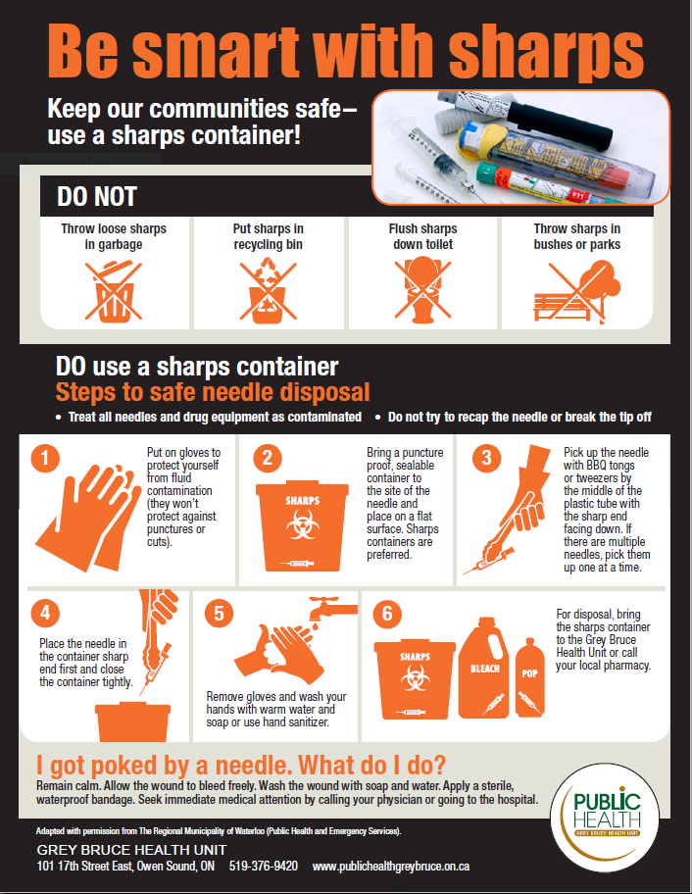
Notes:
Poster available on GBHU website

Slide 21
References
Bridgeman, J., & LePage, R. (2017). Safe Sharps Disposal Toolkit. A Community Response to a Community Issue. Retrieved from https://www.interiorhealth.ca/sites/Partners/HarmReduction/Documents/Safe%20Sharps%20Disposal%20Toolkit.pdf
Ministry of Community Safety and Correctional Services. (2017). Community Safety and Well-being Planning Framework: A Shared Commitment in Ontario. Retrieved from https://www.mcscs.jus.gov.on.ca/sites/default/files/content/mcscs/docs/Booklet%203%20A%20Shared%20Commitment%20Final%20Dec%202018.pdf
Sudbury and District Health Unit. (2017). Safe needle disposal. Retrieved from https://www.phsd.ca/wp-content/uploads/2017/08/Safe_Needle_Disposal_Toolkit_2017.pdf
Toronto Public Health. (2018). Needle Disposal: Guidance for Policies and Procedures. Retrieved from https://www.toronto.ca/wp-content/uploads/2018/12/8dbc-Needle-Disposal-Guidance.pdf

